Slide 1
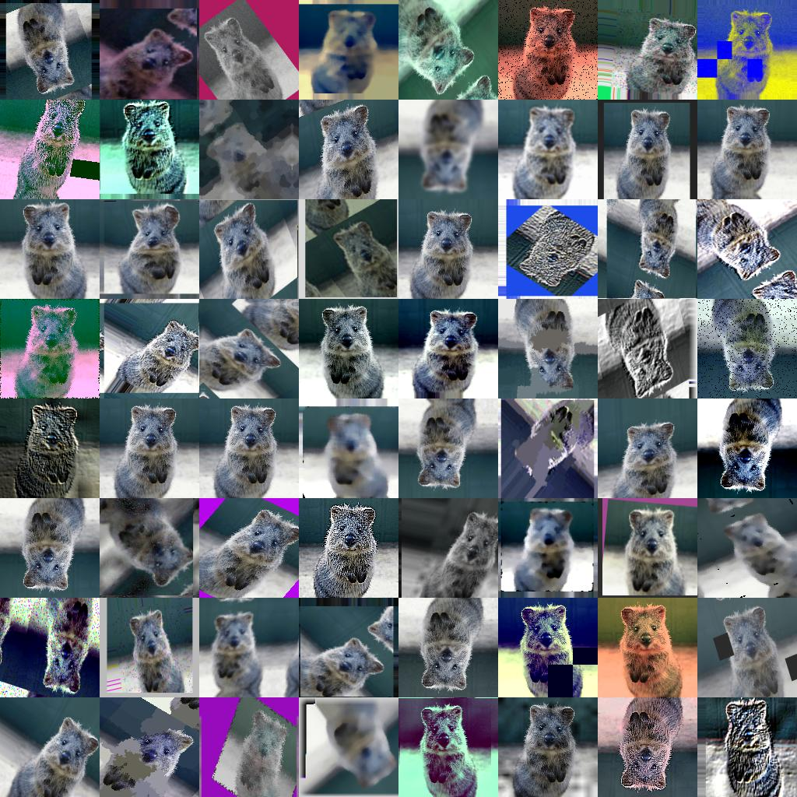
ImgAug Studio
Build, visualize and export custom augmentation pipeline

Slide 2
ImgAug Studio
Build, visualize and export custom augmentation pipeline

